Slide 1
Imagination
Of
Artificial
Intelligence
Imagination
Of
Artificial
Intelligence
Li Zhaoyang
Department of Automation

Slide 2
content
3
Imagination needs practice
2
New intelligence
Needs imagination
1
Multiple kinds of imagination

Slide 3
01
Multiple kinds of imagination

Slide 4
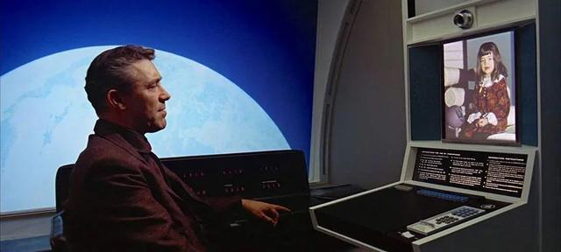
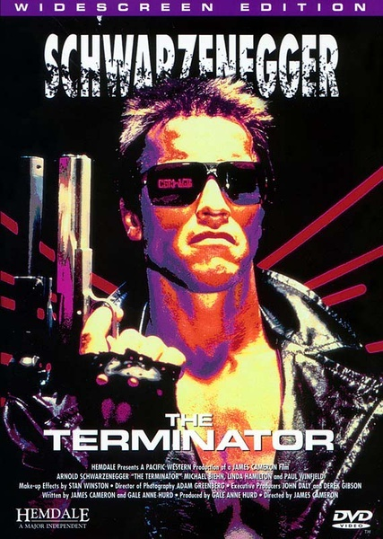
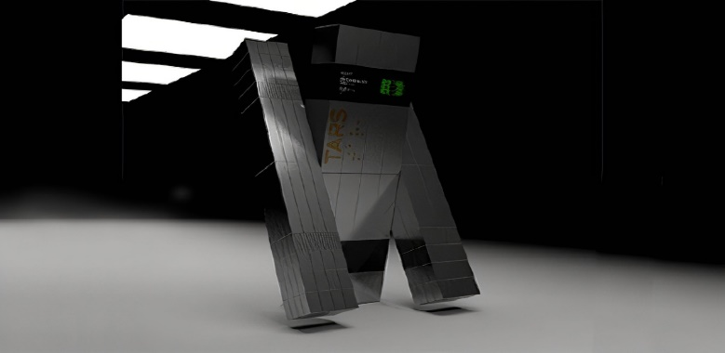
Movie
Documentary
Books
2001: A Space Odyssey
Interactive Computer
Interstellar
Assistant Robot
The Terminator
Intelligence Robot
The imagination of artificial intelligence is with great diversity

Slide 5
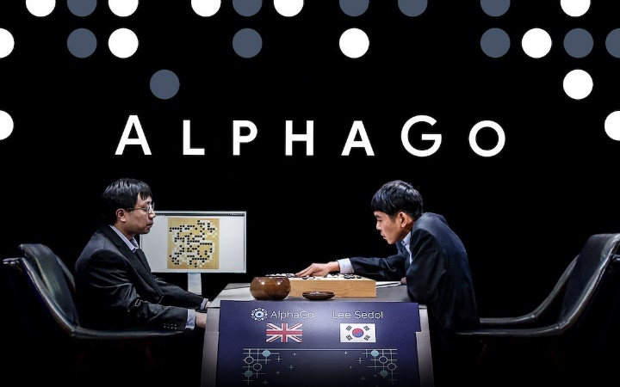
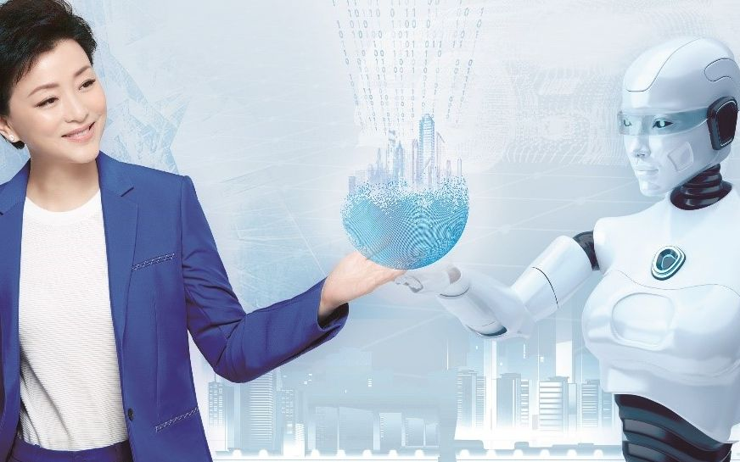
Movie
Documentary
Books
AlphaGo
Looking for AI
The imagination of artificial intelligence is with great diversity

Slide 6
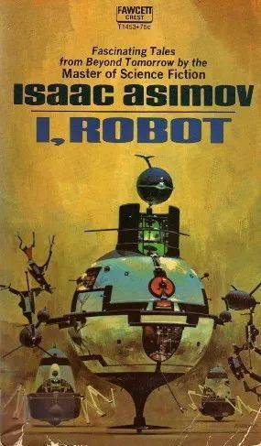
Movie
Documentary
Books
Lie zi_Tang wen ->
Yanshi offering puppet
Metamorphoses -> Galatea
I, robot
The imagination of artificial intelligence is with great diversity

Slide 7
02
New intelligence Needs imagination

Slide 8
The imagination of litterateur is foresighted
I, robot -> Three Laws of Robotics
2001：A Space Odyssey -> Siri
The Terminator -> High Performance Robot

Slide 9
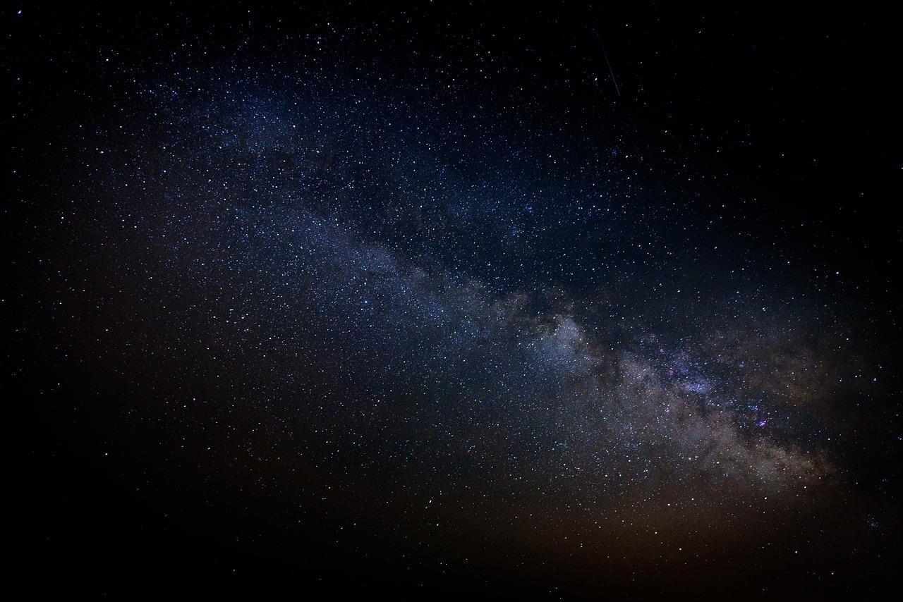
The imagination of scientists tends to practice
The first climax of AI-> Artificial Neural Network
The second climax of AI-> Expert System
The third climax of AI-> Deep Learning

Slide 10
03
Imagination needs practice

Slide 11
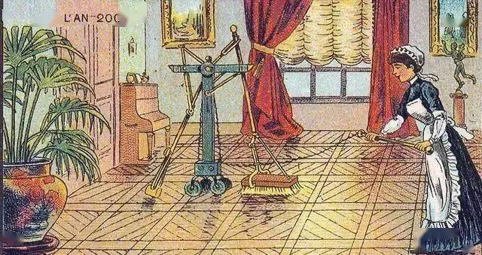
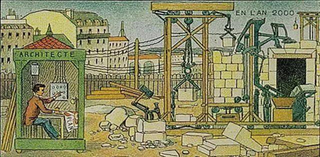
“
Floor-cleaning robot from the imagination of 1900
Construction-robot from the imagination of 1900

Slide 12
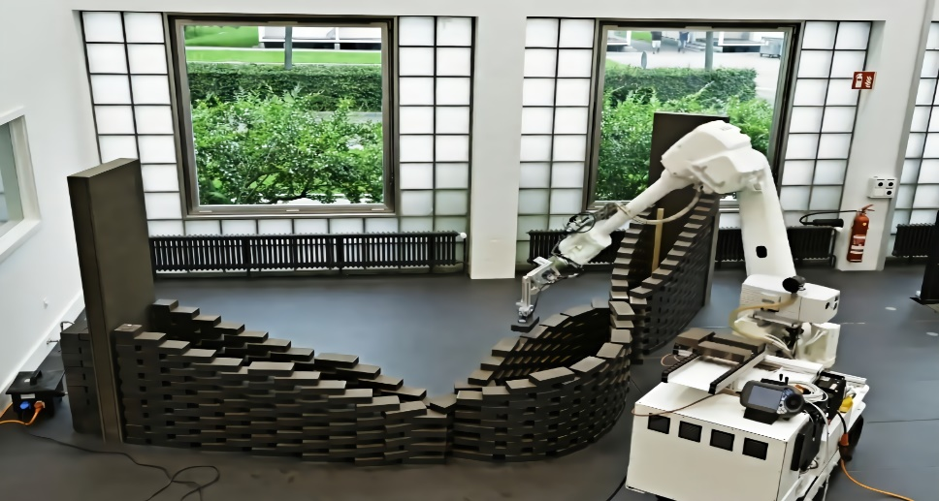
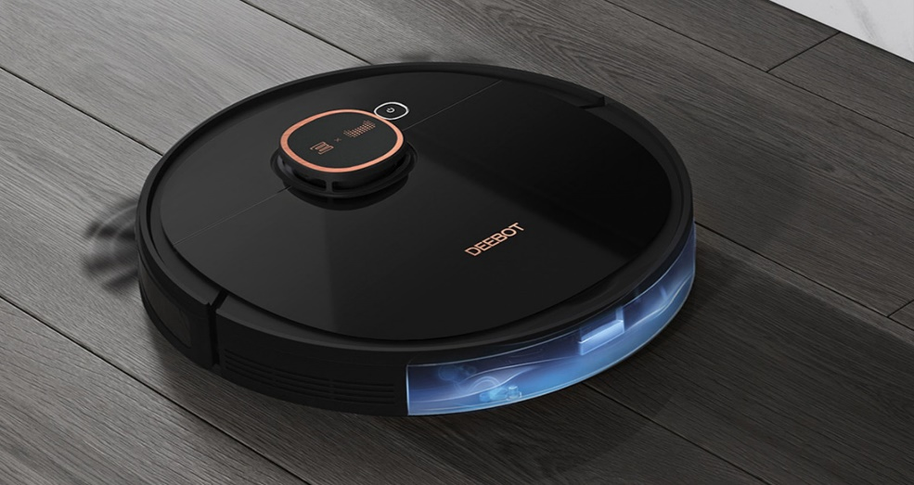
“
Floor-cleaning robot from the imagination of 2022
Construction-robot from the imagination of 2022

Slide 13
Thank you
Thank you
Li Zhaoyang
Department of Automation

